Slide 1
Graph Coloring Problem
using Backtracking

Slide 2
GRAPH COLOURING PROBLEM
Let G be a graph and m be a positive integer .
The problem is to color the vertices of G using only m colors in such a way that no two adjacent nodes / vertices have the same color.
It is necessary to find the smallest integer m. m is referred to as the chromatic number of G.

Slide 3
GRAPH COLOURING PROBLEM (Contd..)
A map can be transformed into a graph by representing each region of map into a node and if two regions are adjacent, then the corresponding nodes are joined by an edge.
For many years it was known that 5 colors are required to color any map.
After a several hundred years, mathematicians with the help of a computer showed that 4 colours are sufficient.

Slide 4
Solving the Graph Colouring Problems
The graph is represented by its adjacency matrix Graph (1:n,1:n) where GRAPH (i,j) = true if <i,j> is an edge and Graph (i,j) = false otherwise.
The colours will be represented by the integers 1,2….m and the solution with n– tuple (X(1),….X(n)), where X(i) is the colour of node i.

Slide 5
Solving the Graph Colouring Problems (Contd..)
The solution can be represented as a state space tree.
Each node at level i has m children corresponding to m possible assignments to X(i) 1≤i≤m.
Nodes at level n+1, are leaf nodes. The tree has degree m with height n+1.

Slide 6
Graph Coloring
As an example:
  The vertices are enumerated in order A-F
  The 3 colors to be used.
A
B
F
C
E
D

Slide 7
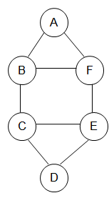
Graph Coloring

Slide 8
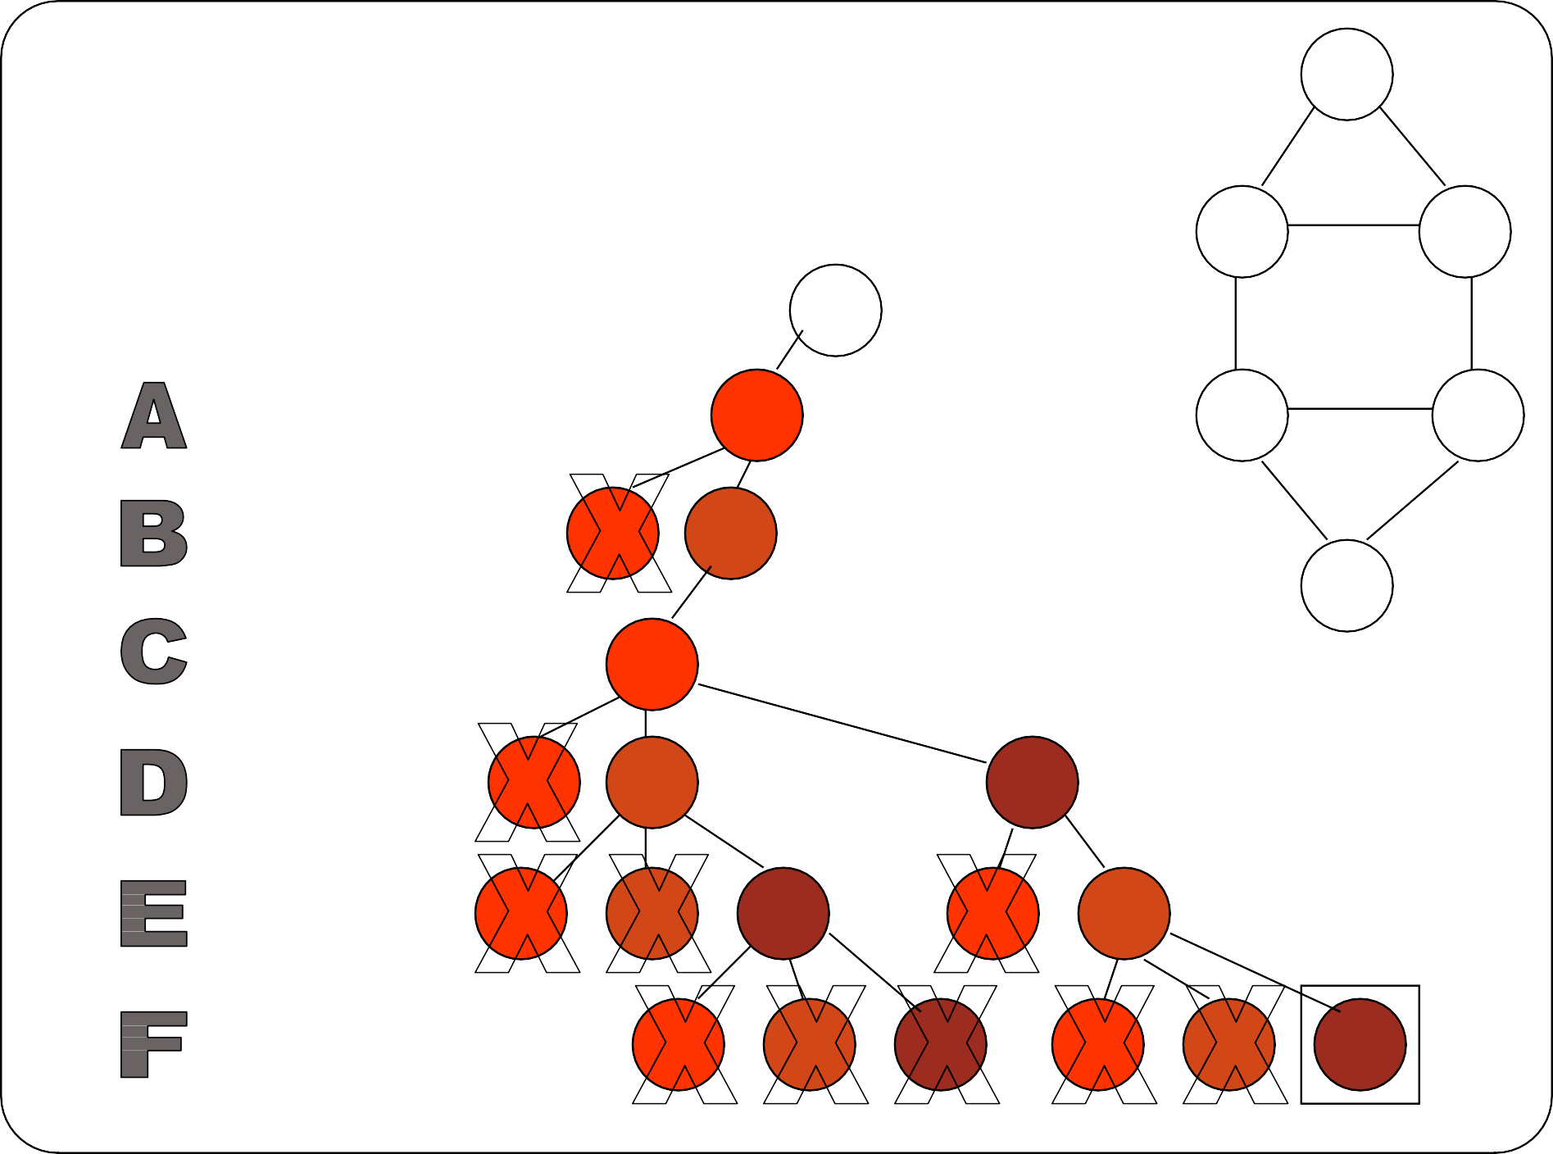
Graph Coloring
A
B
F
C
E
D

Slide 9
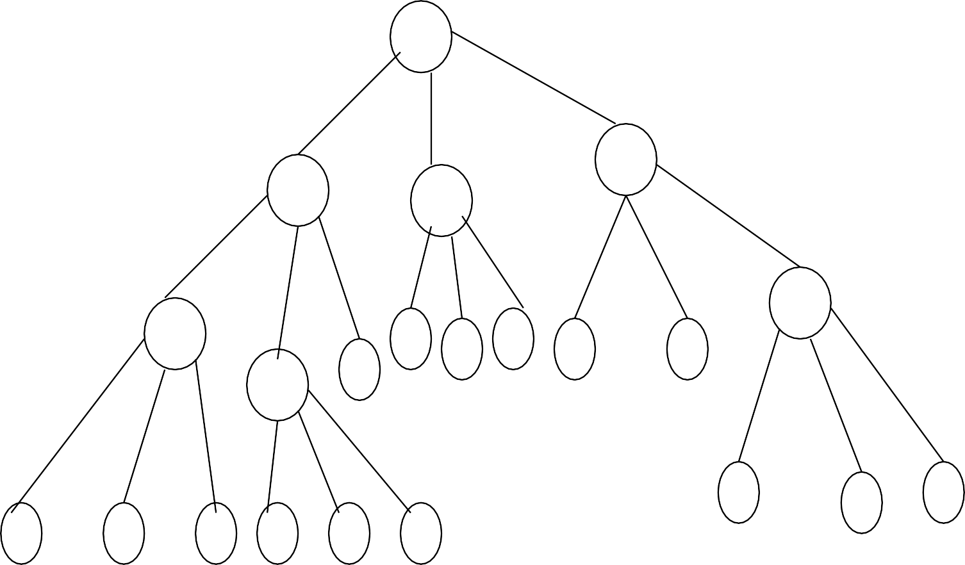
State space tree for m colouring problem with n = 4 and m = 3
1
X(1)=1
X(1)=3
X(1)=2
2
X(2)=1
2
3
3
X(3)=1
2 3
4
5
6

Slide 10
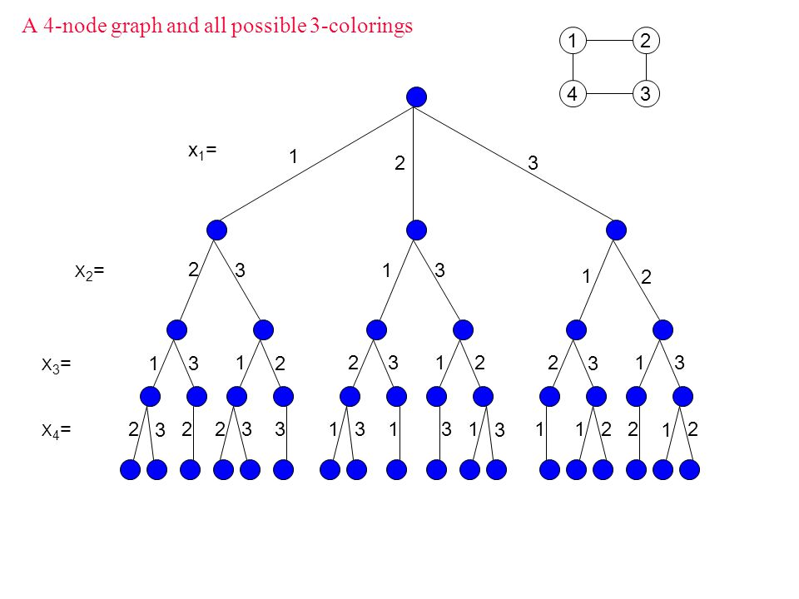

Slide 12
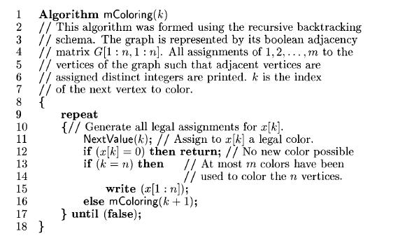
Graph Colouring Problem- Algorithm

Slide 13
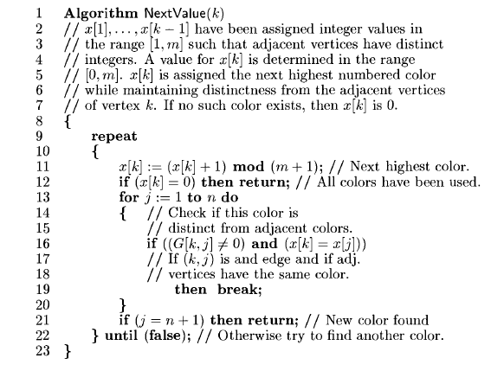
Graph Colouring Problem- Algorithm (Cont…)

Slide 14
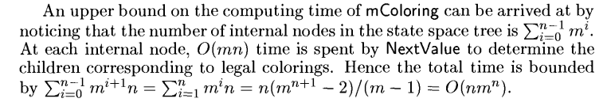
Time complexity

